Slide 1


Slide 2

New Product Launch

Slide 3

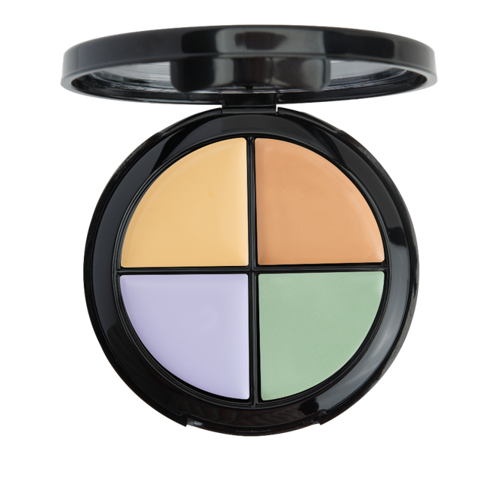
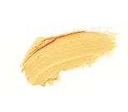



Yellow
Neutralises hyperpigmentation and dark spots on all skin tones
Peach
Neutralises dark under-eye circles, dark spots and brightens fair/medium skin tones.
Green
Counteracts redness (i.e. from rosacea, acne, broken capillaries and sunburn)
Lavender
Neutralises dullness on light, tan, or olive skin with yellow undertone.
LIGHT TO MEDIUM
SG200CW
UC: S$19.75 | SR: S$27.50
BV: 9

Slide 4
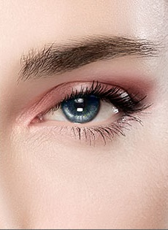
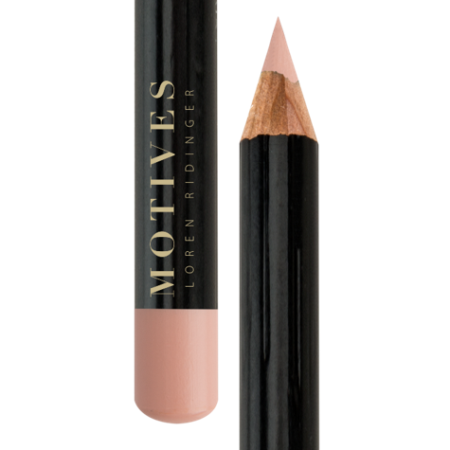
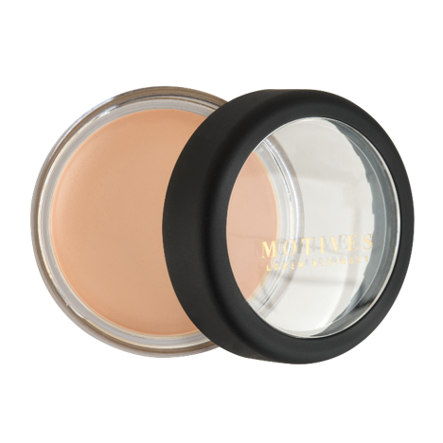
MOTIVES® KHOL EYELINER
MOTIVES® CRÈME CONCEALER
Bare
SG45MEP | UC: S$19.50
SR: S$27.00 | BV: 8.5
Peach
SG005MC | UC: S$21.25
SR: $30.00 | BV: 10

Slide 5
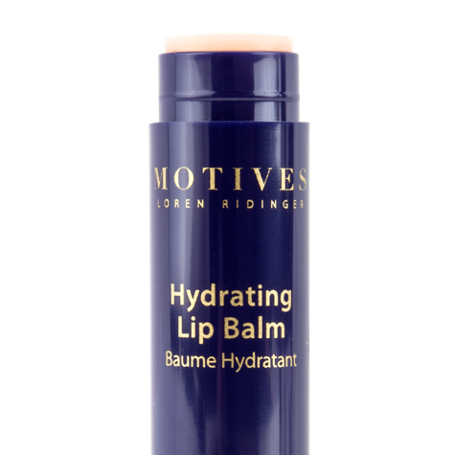
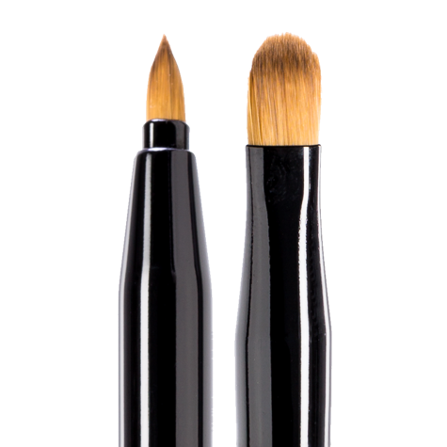
MOTIVES® HYDRATING LIP BALM
MOTIVES® FOR LA LA RETRACTABLE LIP AND EYE BRUSH
SG0153
UC: S$21.25
SR: S$29.95 | BV: 10
SG31MLMBR
UC: S$14.50
SR: S$20.00 | BV: 4

Slide 6
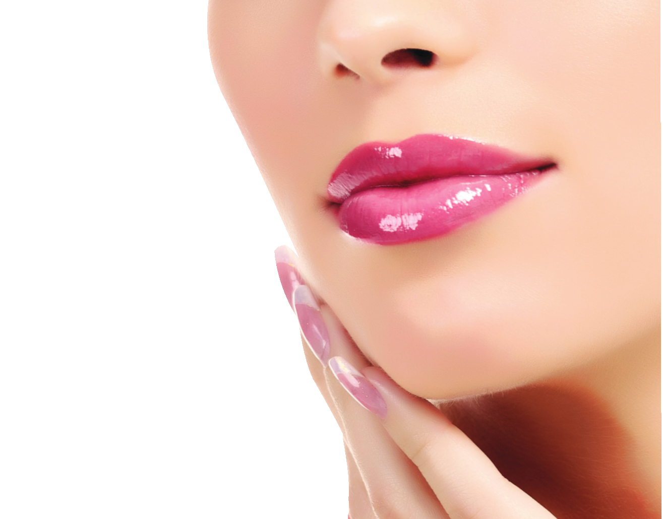
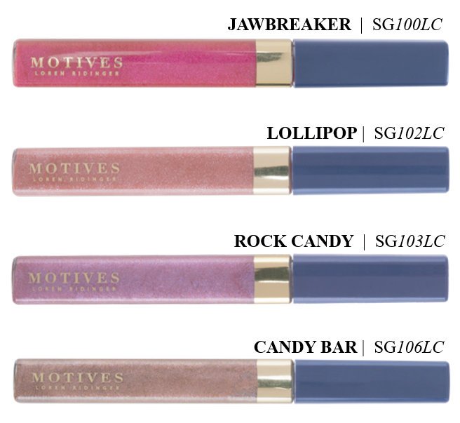
MOTIVES® LIP CANDIES
UC: S$19.75 | SR: S$27.50 | BV: 9

Slide 7
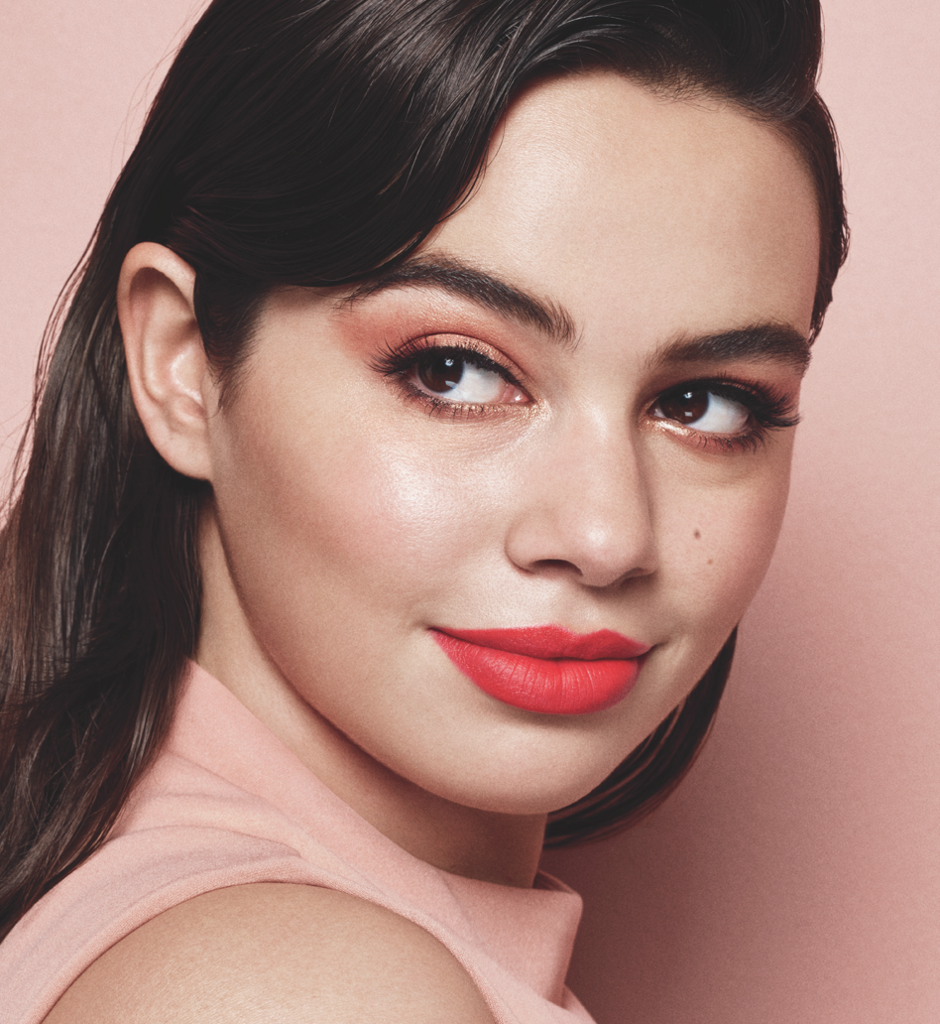
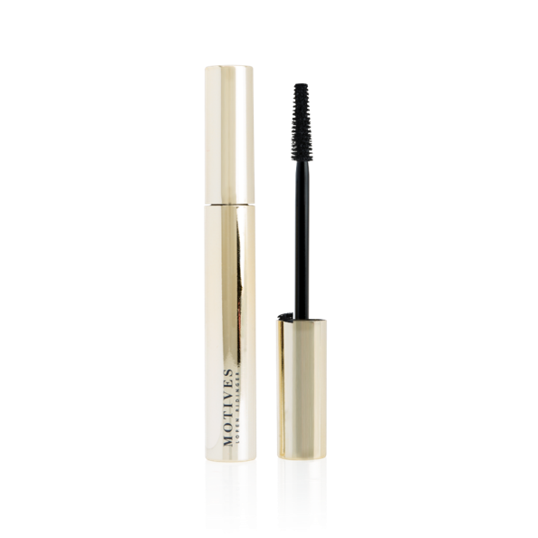
MOTIVES® FIBER LUSH MASCARA
COMING SOON
SG100MFM
UC: S$32.50 | SR: $45.50
BV: 15

Slide 8
Yellow
Neutralises hyperpigmentation and dark spots on all skin tones
Peach
Neutralises dark under-eye circles, dark spots and brightens fair/medium skin tones.
Green
Counteracts redness (i.e. from rosacea, acne, broken capillaries and sunburn)
Lavender
Neutralises dullness on light, tan, or olive skin with yellow undertone.
LIGHT TO MEDIUM
SG200CW
UC: S$19.75 | SR: S$27.50
BV: 9

Slide 9
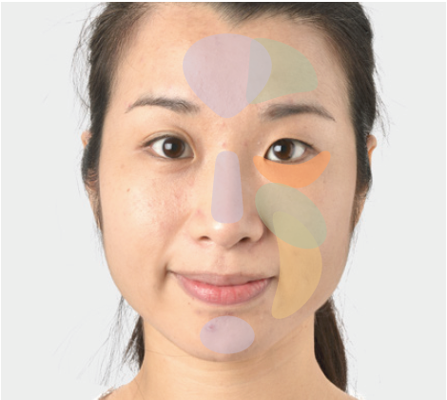
Motives® Color Correction Quad
Before & After

Slide 10

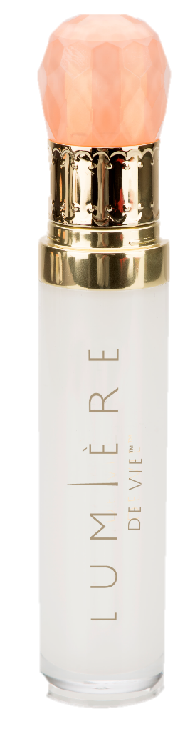
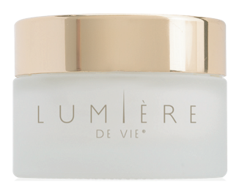
LUMIÈRE DE VIE®
BRIGHTENING KIT
Contains
  Illuminating Fading Fluid
  Super Crème
Save up to 18% compared to buying individual products
Helps reduce the appearance of age/dark spots and hyperpigmentation
Moisturises to give skin a smoother and softer appearance
SG12218 | UC: S$ 133.00 | SR: S$ 185.00 | BV: 60

Slide 11

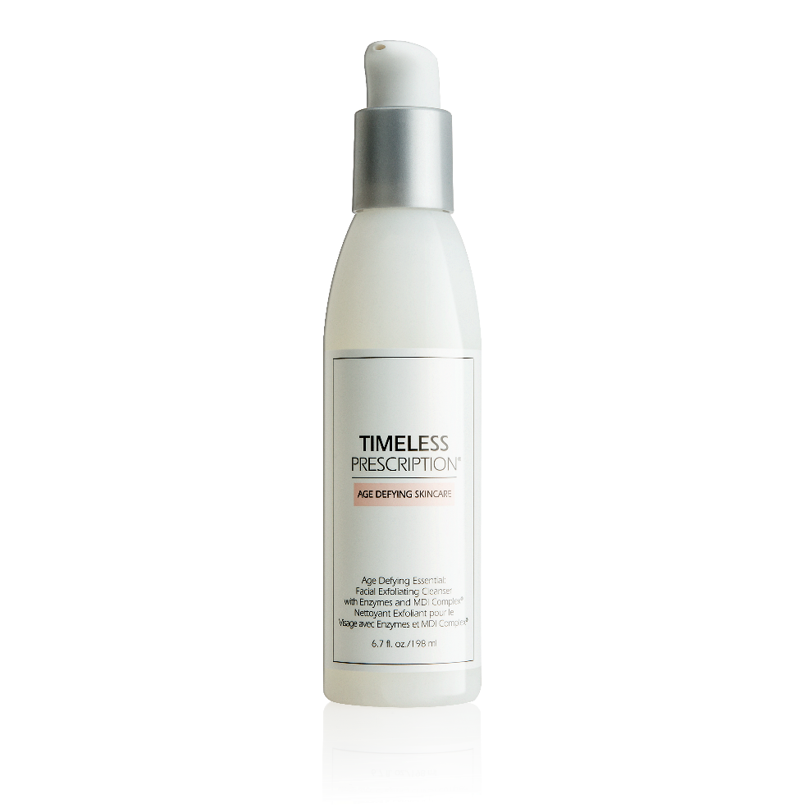
FACIAL EXFOLIATING
CLEANSER WITH ENZYMES
Cleans skin without tightness
Promotes smoother, softer skin
Provides noticeably firmer-looking
and more supple skin
Gently removes dead skin
pH balanced
Ideal for all skin types
SG11120
UC: S$44.00 | SR: S$61.50 | BV: 21
Notes:
Enzymes: Bromelain (from pineapple) & Papain (from papaya) – removes dead skin

Slide 12
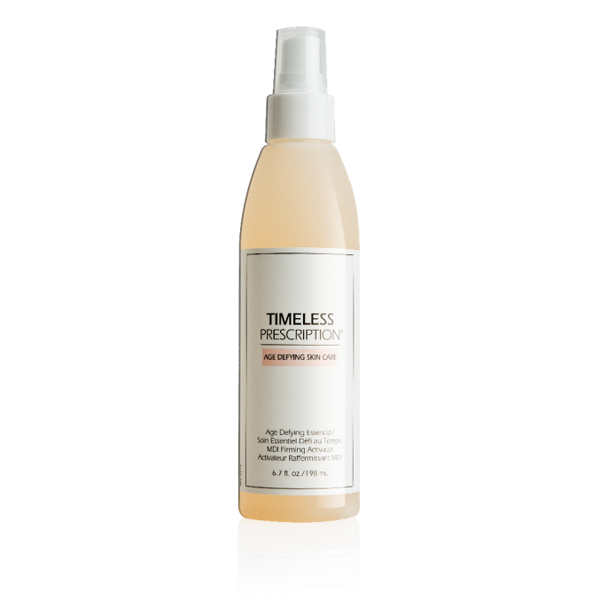
MDI FIRMING
ACTIVATOR
Tones skin
Promotes retention of moisture
in the skin
Promotes elasticity
SG11122
UC: S$44.00 | SR: S$61.50 | BV: 21
Notes:
Enzymes: Bromelain (from pineapple) & Papain (from papaya) – removes dead skin

Slide 13
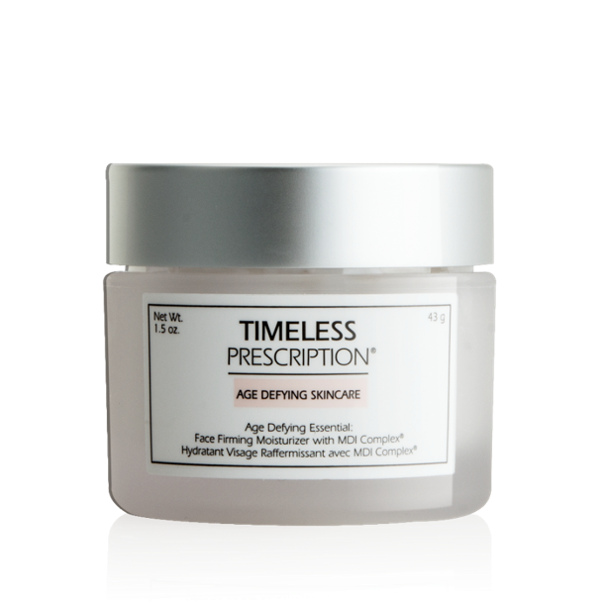
FACE FIRMING MOISTURIZER
WITH MDI COMPLEX
Helps moisturise and hydrate the skin
Soothes skin and gives it a healthy glow
Provides the skin protection from free radicals
SG11124
UC: S$60.00 | SR: S$85.00 | BV: 30
Notes:
Enzymes: Bromelain (from pineapple) & Papain (from papaya) – removes dead skin

Slide 14
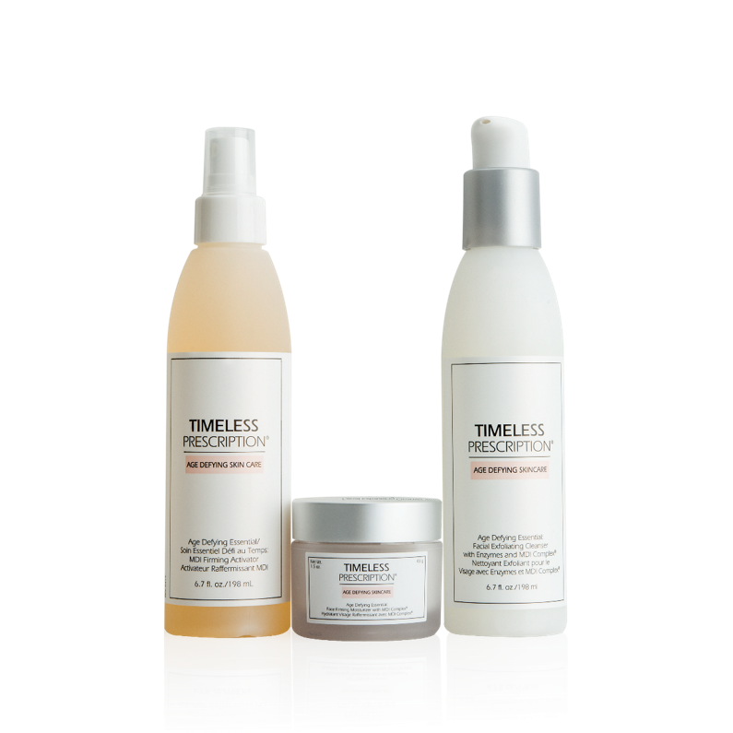
ANTI-AGING
ESSENTIALS 3 PIECE KIT
Contains
  Facial Exfoliating Cleanser
  With Enzymes
  Mdi Firming Activator
  Face Firming Moisturizer
  With MDI Complex
Save over 12% compared to buying
individual product
SG11134
UC: S$130.00 | SR: S$185.00 | BV: 66
Notes:
Enzymes: Bromelain (from pineapple) & Papain (from papaya) – removes dead skin

Slide 15
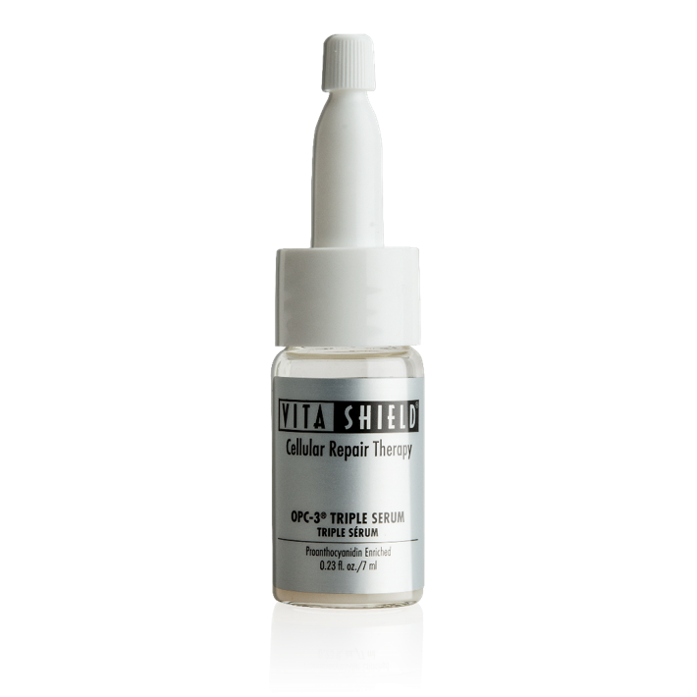
OPC-3™
TRIPLE SERUM
Protects against the effects of
free radicals
Promotes healthy skin elasticity
and firmness
Promotes healthy skin regeneration
for smooth, radiant looking skin
Refines skin tone
Promotes skin’s moisture retention
SG11134
UC: S$130.00 | SR: S$185.00 | BV: 66
Notes:
Enzymes: Bromelain (from pineapple) & Papain (from papaya) – removes dead skin

Slide 16




STAY UPDATED WITH MOTIVES® COSMETICS
MOTIVESMASG
MOTIVESCOSMETICS
SG.MOTIVESCOSMETICS.COM
MOTIVES

